Slide 1
ESG AND FINANCIAL PERFORMANCE ANALYSIS
Analysis report based on ESG pillars (Environmental, Social, and Governance) and financial performance.

Slide 2
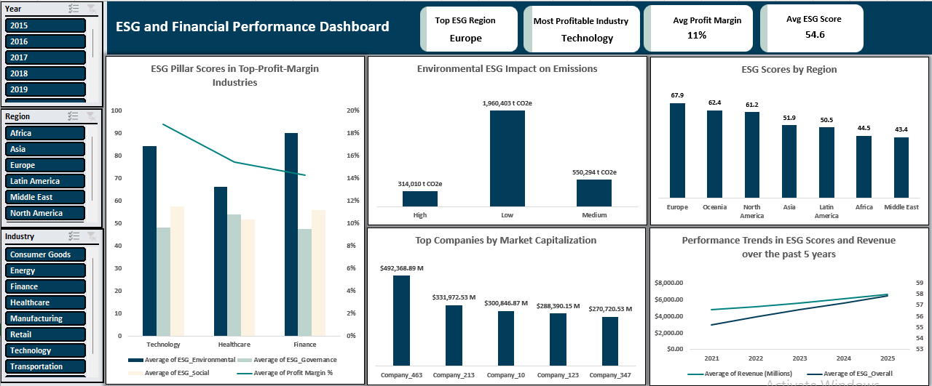
ESG AND FINANCIAL PERFORMANCE DASHBOARD

Slide 3
INTRODUCTION
Businesses are being judged on their ethical practices in addition to their financial performance as a result of the increased focus on sustainability around the world.
ESG (Environmental, Social, and Governance) performance is now a crucial indicator of long-term value, ethical practices, and risk management.
This project investigates whether stronger financial outcomes, such as revenue growth, profitability, and market value, are associated with higher ESG scores across industries, regions, and companies from 2015 to 2025.

Slide 4
OBJECTIVES
To identify high- and low-performing companies based on ESG performance.
To investigate which ESG pillars (Environmental, Social, and Governance) most strongly correlate with financial success.
To recognise patterns and trends in ESG and financial performance across different industries and regions.

Slide 5
PROBLEM STATEMENT
The dataset explores the relationship between ESG performance and key financial metrics across companies, industries, and regions.
The project aims to analyse how ESG scores in Environmental, Social, and Governance categories influence financial outcomes such as revenue, profit margin, market capitalization, and growth rate.

Slide 6
BUSINESS QUESTIONS
Which industries have shown the highest average ESG scores, and how do their profit margins compare to industry averages?
How does Environmental ESG performance relate to carbon emissions?
Which regions score highest in ESG performance?
Which companies have the largest market capitalization?
What trends can be observed in ESG overall scores and revenue growth over the past 5 years?

Slide 7
ANALYSIS AND FINDINGS
KEY PERFORMANCE INDICATORS (KPIs):
Top ESG Region – Europe(67.9): Leads with the highest ESG performance, driven by strong regional sustainability policies.
Most profitable industry – Technology(19%): Performs better than other industries, showing strong financial gains associated with ESG performance.
Average profit margin – 11%: Shows overall financial stability across industries, with potential for ESG-driven growth.
Average ESG score – 54.6%: Shows a reasonable foundation, with room for improvement in lagging industries.

Slide 8
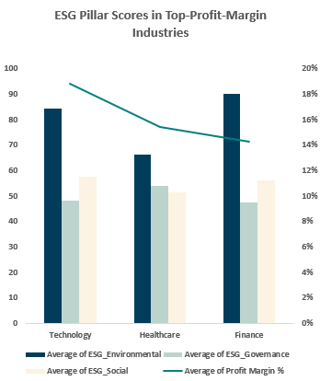
ESG Pillars vs Profit Margin (Top Industries)
This combo chart compares the top 3 industries’ ESG(Environmental, Social, and Governance) scores by profit margin (Technology, Healthcare, Finance). The green line represents the average profit margin.
Insights:
Technology has the highest profit margin and strong Environmental and Governance scores. Finance has strong Environmental scores but lower profit due to weaker Social and Governance performance.

Slide 9
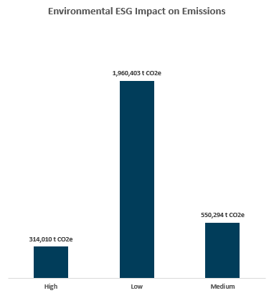
Environmental ESG vs Emissions
Bar chart comparing carbon emissions and ESG Environment categories.
Insights:
Companies with high Environmental ESG scores have significantly lower carbon emissions than those with low scores.

Slide 10
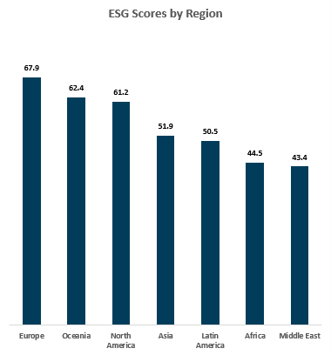
ESG Scores by Region
Bar chart comparing ESG scores across regions.
Insights:
Europe has the highest ESG scores. Africa and the Middle East have the lowest scores among all regions.

Slide 11
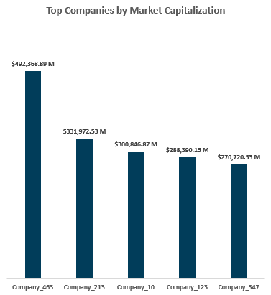
Top Companies by Market Capitalization
Bar chart comparing top companies by market capitalization.
Insights:
Company 463, a technology company, has the largest market capitalization, others like companies 596 and 355 also show high valuation.

Slide 12
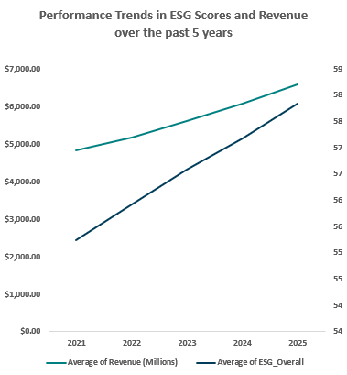
ESG and Revenue Trend (2021-2025)
The double line chart illustrates the year-over-year trend of average ESG scores and average revenue from 2021 to 2025.
Insights:
From 2021 to 2025, ESG scores rose steadily while revenue increased by 36.6%, suggesting a positive correlation between ESG performance and financial growth.

Slide 13
RECOMMENDATIONS
To promote accountability, incorporate ESG into core business strategy and tie executive rewards to ESG indicators.
Prioritize industries like Technology, and Finance for their proven relationship between ESG and financial performance.
Improve ESG balance and profitability by strengthening Social and Governance practices in Finance, and Social practices in Technology.
To increase ESG maturity and draw in investment, invest in policy incentives and training across the Middle East, Africa, and Latin America.
Set a target to achieve a 25% decrease in emissions by 2027, through innovations such as renewable energy, which will promote growth and sustainability.
To provide financial support for ESG goals, use ESG bonds and sustainability-linked loans to fund ethical projects.
Develop processes to track ESG development so that stakeholders can make data-driven decisions and have transparency.

Slide 14
CONCLUSION
This project proves that ESG is not just about ethics, it is a driver of real financial performance. Companies with strong ESG scores showed higher revenue, lower emissions, and better growth. As sustainability continues to shape investment and strategy, ESG leadership is now a business advantage, not just a responsibility.

